Slide 1

Simon Coupland
Competency Portfolio
www.infratec-uk.com

Slide 2
Competency Summary
Category | Accreditation Body | No. | Expiry
Slinger / Signaller | ALLMI | 65314 | 06/06/2027
Emergency First aid at work (Lvl 3) | Qualsafe Awards | 3024686 | 14/02/2026
PAL - Static Boom (1b) | IPAF | OP/1974503 | 31/05/2026
Confined Space Safe Entry & Self Rescue | IIRSM | CS-02 10056 | 12/02/2026
Highways Electrical Registration Scheme | HEA | HO243127 | 06/12/2026
National Highways Safety Passport | National Highways | 14-00013957 | 17/02/2026
Working at Height Level 2 | QualSafe Awards | 3021027 | 15/02/2026
CPCS Crane / Lifting operations supervisor | CSCS | 40942762 | 07/12/2025
www.infratec-uk.com

Slide 3
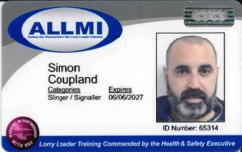
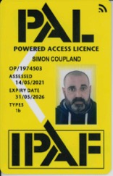

Competency Cards
IPAF
ALLMI
HERS
www.infratec-uk.com

Slide 4
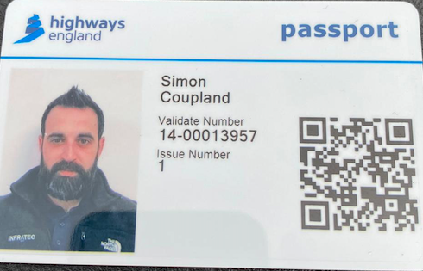
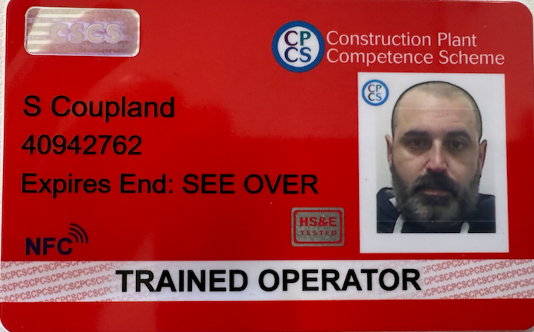
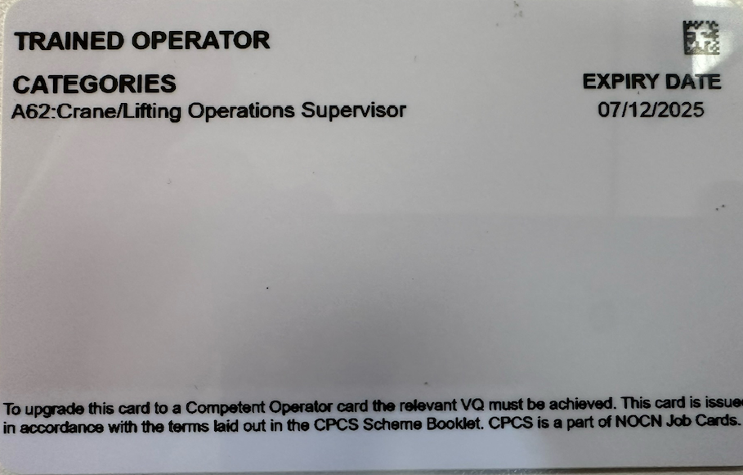
Competency Cards (cont.)
National Highways Safety Passport
CSCS
www.infratec-uk.com

